Slide 1
Java class
Slider、File Chooser
2016/4/26

Slide 2
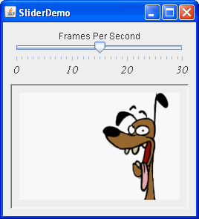
Slider
A JSlider component is intended to let the user easily enter a numeric value bounded by a minimum and maximum value. If space is limited, a spinner is a possible alternative to a slider.
Java doc

Slide 3
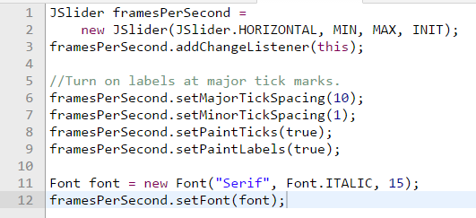
Slider

Slide 4
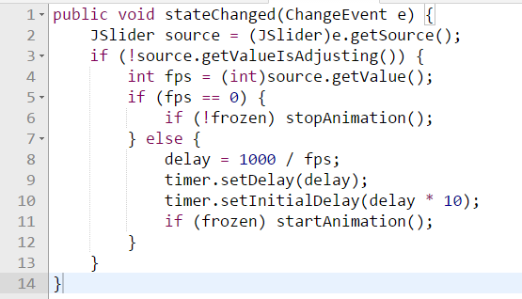
slider
When you move the slider's knob, the stateChanged method of the slider's ChangeListener is called.

Slide 5
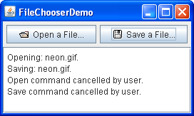
File chooser
File choosers provide a GUI for navigating the file system, and then either choosing a file or directory from a list, or entering the name of a file or directory. To display a file chooser, you usually use the JFileChooser API to show a modal dialog containing the file chooser. Another way to present a file chooser is to add an instance of JFileChooser to a container.
Java doc

Slide 6
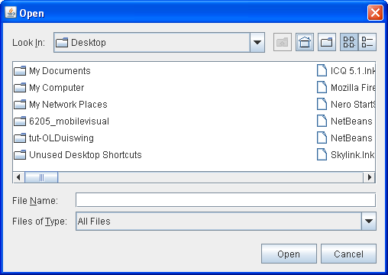

Slide 7
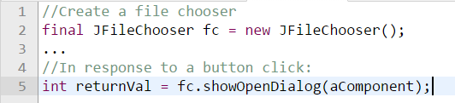
File chooser
The argument to the showOpenDialog method specifies the parent component for the dialog. The parent component affects the position of the dialog and the frame that the dialog depends on. For example, the Java look and feel places the dialog directly over the parent component. If the parent component is in a frame, then the dialog is dependent on that frame. This dialog disappears when the frame is minimized and reappears when the frame is maximized.

Slide 8
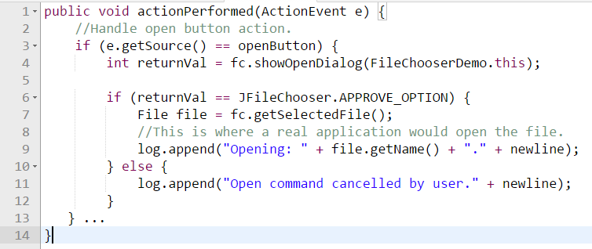
File chooser
The showXxxDialog methods return an integer that indicates whether the user selected a file. Depending on how you use a file chooser, it is often sufficient to check whether the return value is APPROVE_OPTION and then not to change any other value. To get the chosen file (or directory, if you set up the file chooser to allow directory selections), call the getSelectedFile method on the file chooser. This method returns an instance of File.
The example obtains the name of the file and uses it in the log message. You can call other methods on the File object, such as getPath, isDirectory, or exists to obtain information about the file. You can also call other methods such as delete and rename to change the file in some way. Of course, you might also want to open or save the file by using one of the reader or writer classes provided by the Java platform. See Basic I/O for information about using readers and writers to read and write data to the file system.

Slide 9
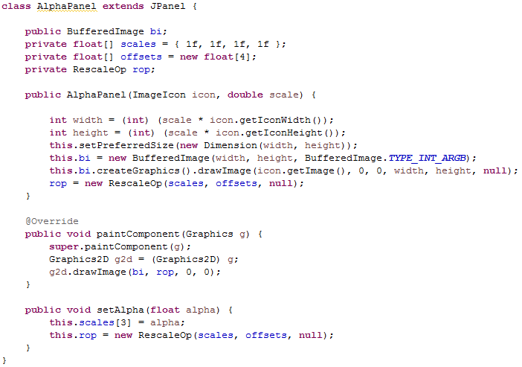
Alpha panel

Slide 10
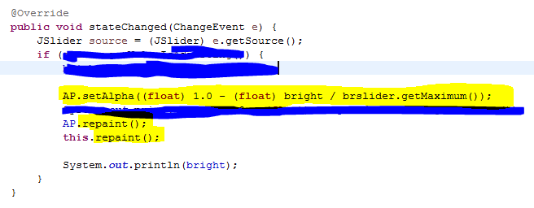
Alpha panel

Slide 11

OpenCV For Java
http://opencv.org/
http://docs.opencv.org/2.4/doc/tutorials/introduction/desktop_java/java_dev_intro.html

Slide 12
Homework
File chooser and slider

Slide 13
作業要求
劃出一個視窗
有一個button可以開啟file chooser讓我選一張照片
選好之後顯示，視窗的大小要能跟著圖片變大變小(fit image size)
要有一個slider，調整照片的透明度
繳交日期和檔案
請將package name命名為A8_學號, 將整個package右鍵加到壓縮檔(zip), 裡面只有你的Java file(main.java, …)
本次作業格式交錯一律0分
Deadline: 2016/5/7 00:00

Slide 14
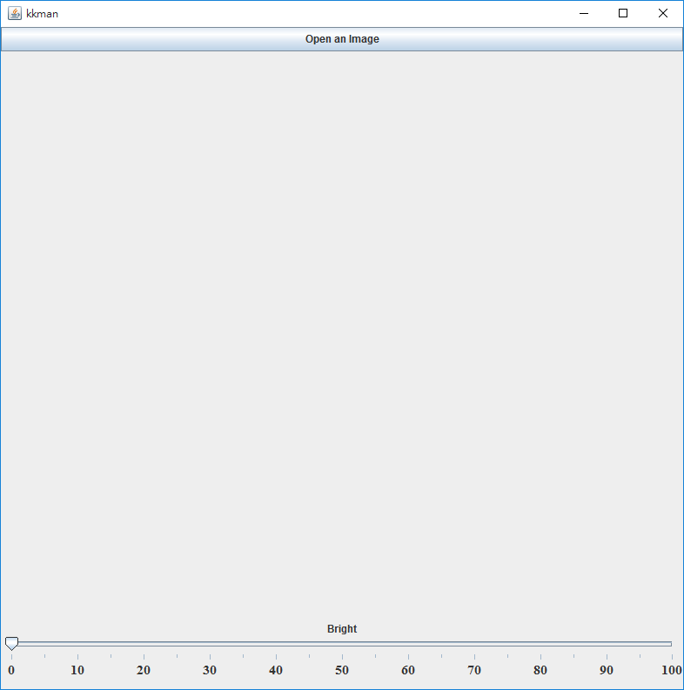
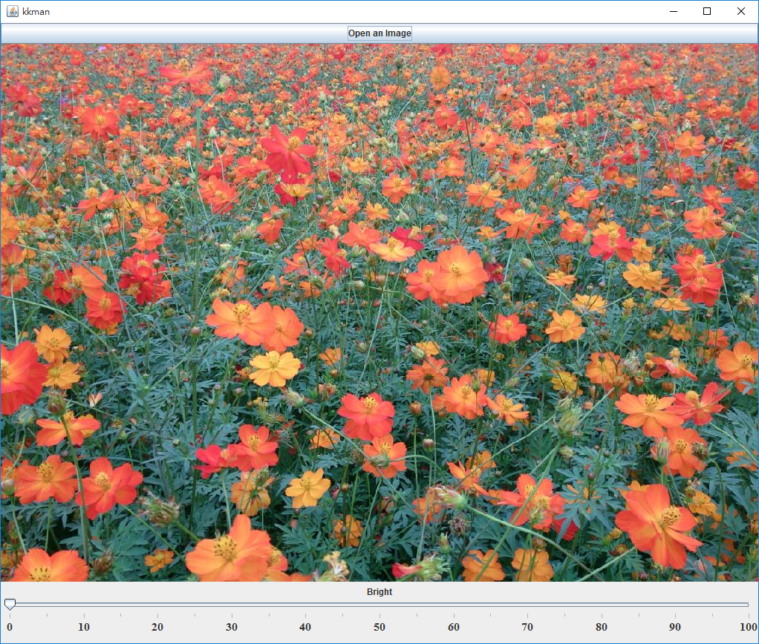
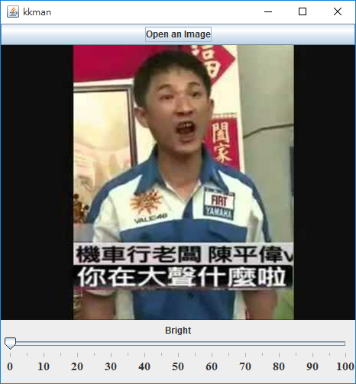

Slide 15
